Slide 1
Scanning Networks

Slide 2
Contents
Introduction
Scanning methodology
Checking for Live systems
Scanning techniques
Scanning countermeasures

Slide 3
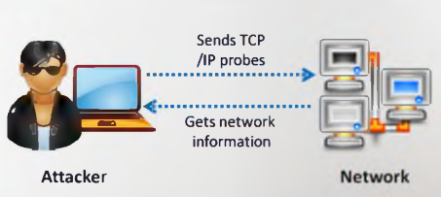










Introduction
Network scanning refers to a set of procedures for identifying hosts, ports, and services in a network.
Network scanning is one of the components of intelligence gathering an attacker uses to create a profile of the target organization
Port được mở, ip
Os
Dịch vụ đang chạy
Lỗ hổng
To discover live hosts, IP address, and open ports of live hosts
To discover operating systems and system architecture
To discover services running on hosts
To discover vulnerabilities in live hosts
Objectives of network scanning

Slide 4
Scanning methodology
Check for live systems
Check for open ports
Scanning beyond IDS
Banner grabbing
Scanning for vulnerabilities
Draw network diagrams
Prepare proxies
Scanning Pen Testing
Check for live systems
Scan for vulnerability
Check for open ports
Draw network diagrams of vulnerabilities hosts
Identify services
Prepare proxies
Attack
Banner Grabbing/OS fingerprinting

Slide 5
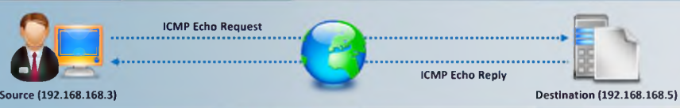
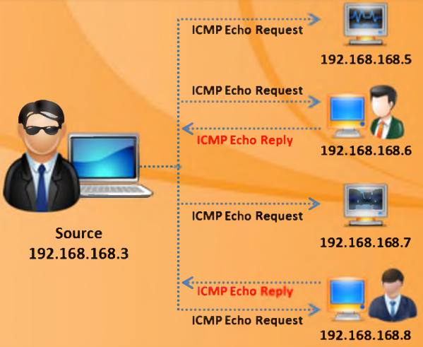










Check for live systems – ICMP Scanning
Ping scan involves sending ICMP echo requests to a host. If the host is live, it will return an ICMP echo reply
This scan is useful for locating active devices or determining if ICMP is passing through a firewall
Tools: Nmap, Angry, IP Scanner, SolarWinds, Ping Scanning Pro,…

Slide 6
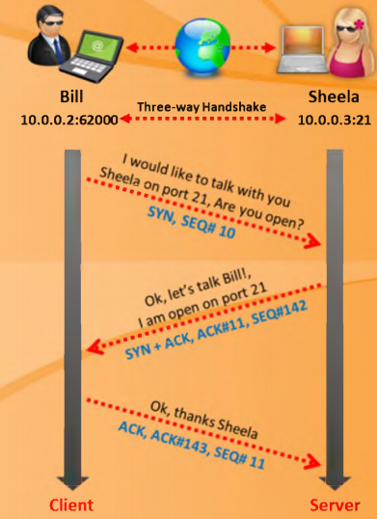
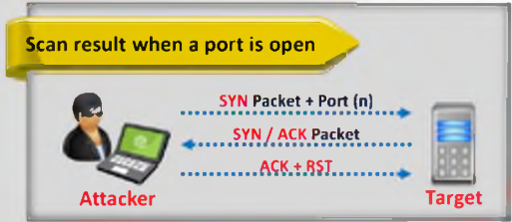
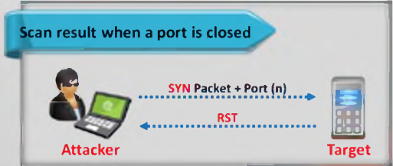


Check for open ports
Three-way handshake: TCP uses a 3-way handshake to establish a connection between server and client
TCP connect scan detects when a port is open by completing the 3-way handshake
TCP connect scan establishes a full connection and tears it down by sending RST packet
Tools: Nmap, Hping

Slide 7

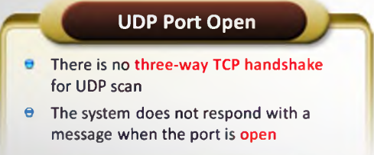
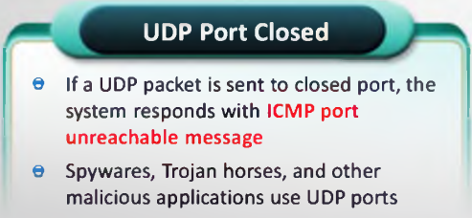








Check for open ports (cont.) – UDP Scanning
Tools: Nmap, NetScan Tools Pro, Advanced Port Scanner,…

Slide 8







Port Scanning Countermeasures
Configure firewall, IDS rules: block unwanted ports
Hide sensitive information from public view
Ensure that mechanism used for routing & filtering at routers, firewalls cannot be bypassed

Slide 9


Scanning beyond IDS
IDS evasion techniques
Use fragmented IP packets
Use source routing
Spoof IP address
Proxy servers

Slide 10








Banner Grabbing
Banner grabbing or OS fingerprinting is the method to determine the operating system running on a remote target system. There are two types of banner grabbing: active and passive
Identifying the OS used on the target host allows an attacker to figure out the vulnerabilities the system poses and the exploits that might work on a system to further carry out additional attacks
Tools: ID Serve, Netcraft, Netcat

Slide 11

Banner Grabbing Countermeasures
Display false banners to misguide the attackers
Turn off unnecessary services on the network host to limit the information disclosure

Slide 12




Vulnerability Scanning
Vulnerability scanning identifies vulnerabilities and weaknesses of a system and network in order to determine how a system can be exploited
Network topology and OS vulnerabilities
Application and services vulnerabilities
Tools: SAINT, OpenVAS, Nexpose, Retina

Slide 13





Draw network diagrams
Drawing target's network diagram gives valuable information about the network and its architecture to an attacker
Network diagram shows logical or physical path to a potential target
Tools: Network View,…

Slide 14
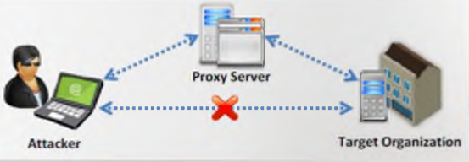
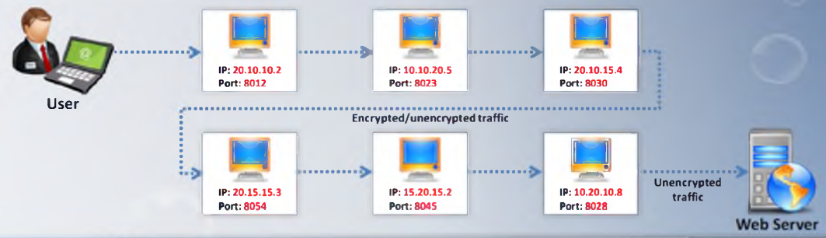


Prepare proxies
A proxy is a network computer that can serve as an intermediary for connecting with other computers
Proxy chaining
Tools: ezProxy,…

Slide 15
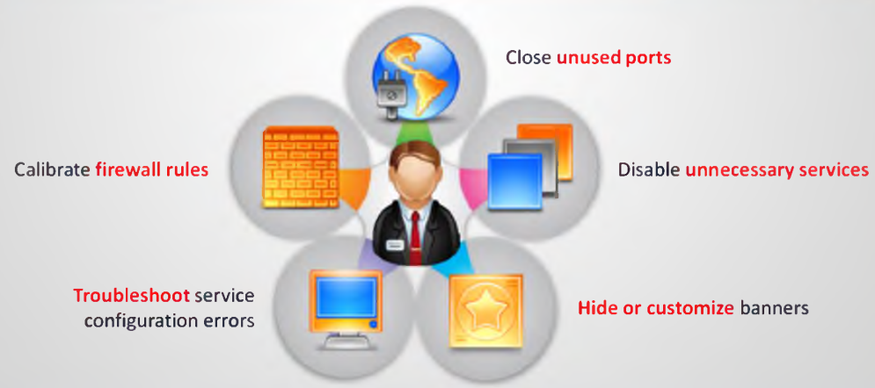












Scanning Pen Testing
Pen testing a network for scanning vulnerabilities determines the network’s security posture by identifying live systems, discovering open ports, associating services and grabbing system banners to simulate a network hacking attempt
The penetration testing report will help system administrators to:

Slide 16
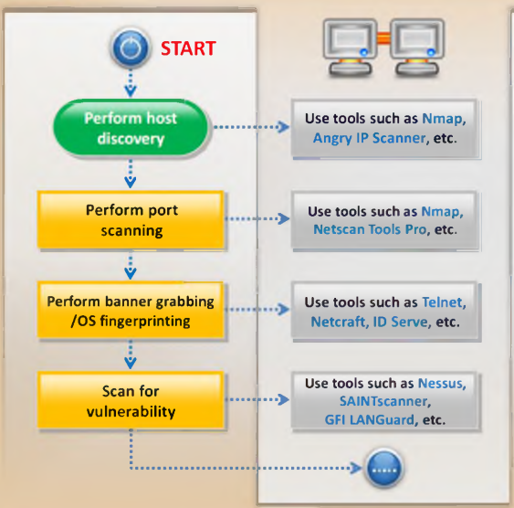
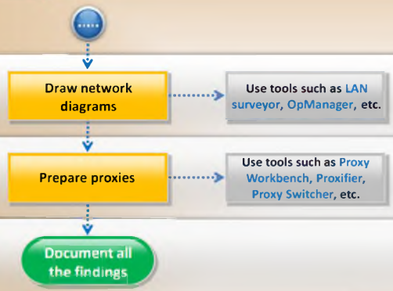

Scanning Pen Testing

Slide 17
Summary
The objective of scanning is to discover live systems, active/running ports, the operating systems, and the services running on the network
Attacker determines the live hosts from a range of IP addresses by sending ICMP ECHO requests to multiple hosts
Attackers use various scanning techniques to bypass firewall rules and logging mechanism, and hide them selves as usual network traffic
Banner grabbing or OS finger printing is the method to determine the operating system running on a remote target system
Drawing target's network diagram gives valuable in formation about the network and its architecture to an attacker
Proxy is a network computer that can serve as an intermediary for connecting with other computers
A chain of proxies can be created to evade a traceback to the attacker
Đóng vai trò trung gian

